Slide 1
Regional training centre
ontario

Slide 2
Introduction Sheilagh Croxon SSO Technical & High Performance Lead

Slide 3
Advantages of the Rtc
1
All inclusive training environment and “whole athlete” training program
Synchro Specific Coaching (2 coaches per routine)
55 minute, semi-private figures sessions 5 days per week
Synchro Swim Ontario HP Tech Lead Workshops
CSIO Strength and Conditioning Expert and Nutritionist
CSIO Sport Medicine (Doctor, Physiotherapist, Sport Psychologist)
Technical Swimming Coach
Biomechanics Specialist
Acrobatics Coach: Dive Canada
Training environment is monitored by Integrated Sports Team
Access to expert advice on training program from CSIO
Physiologist

Slide 4
Advantages of the Rtc
2
Training with Junior NT/Elite Synchro Athletes and Elite Sport Athletes in the DTE
Training environment is intense and focused
Athletes have great work ethic and determination
Great working relationship between coaches and athletes
Training level of top athletes allows for World Class choreography and Senior level routines
Athlete Pool allows for strong quality duet pairings
National Team Members allow for a strong athlete connection from the National Team standards and the RTC training standards
Shared training with other Elite High Performance Sport Programs (dive, judo, canoe/kayak)
Athlete pool of 18-24 allows for challenges and opportunities for all athletes in the program as well as variation in training teams and expert rotation groups

Slide 5
Advantages of the Rtc
3
World-Class Training Facility:

Slide 6
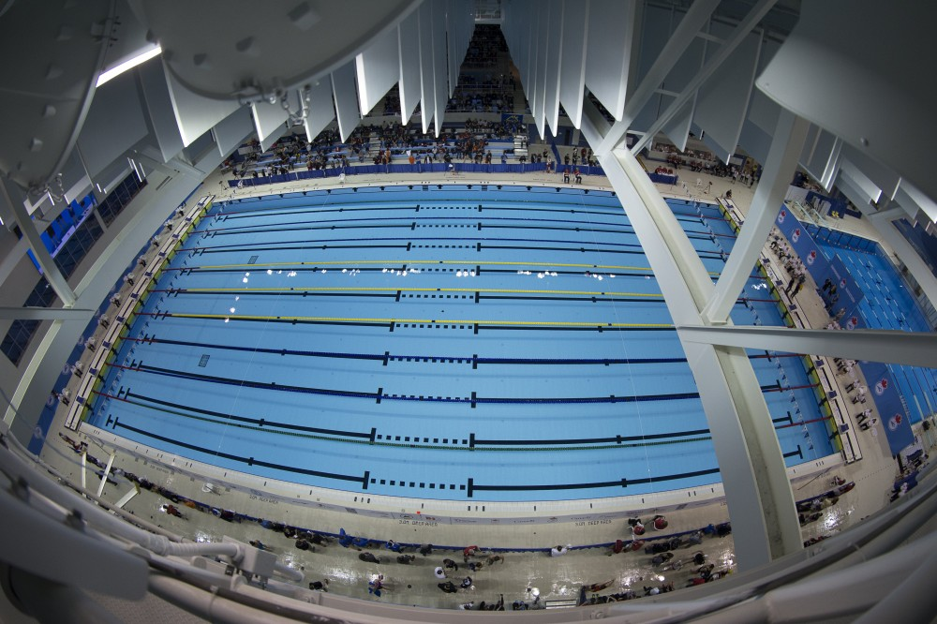
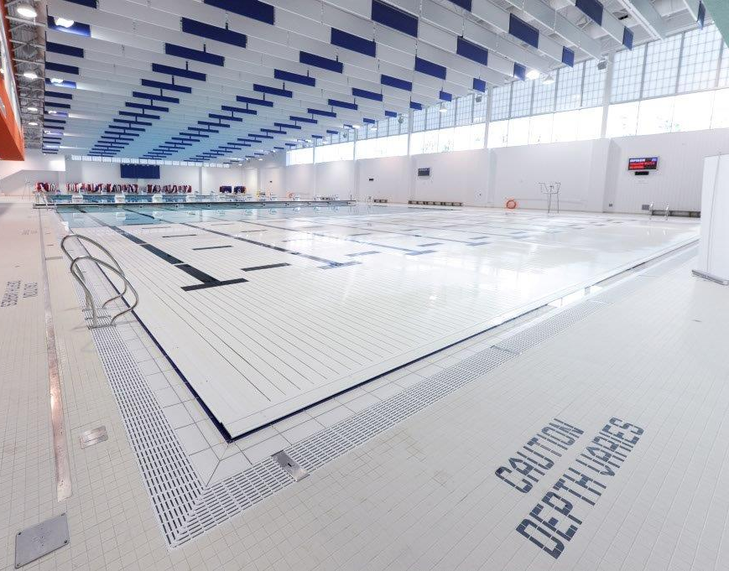
Two 50m Pools

Slide 7
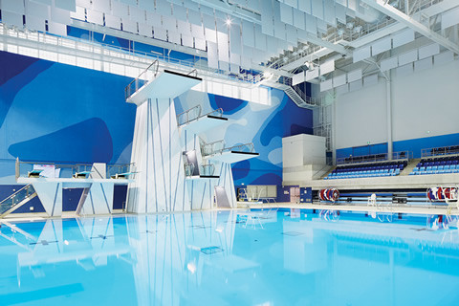
DIVE TANK

Slide 8
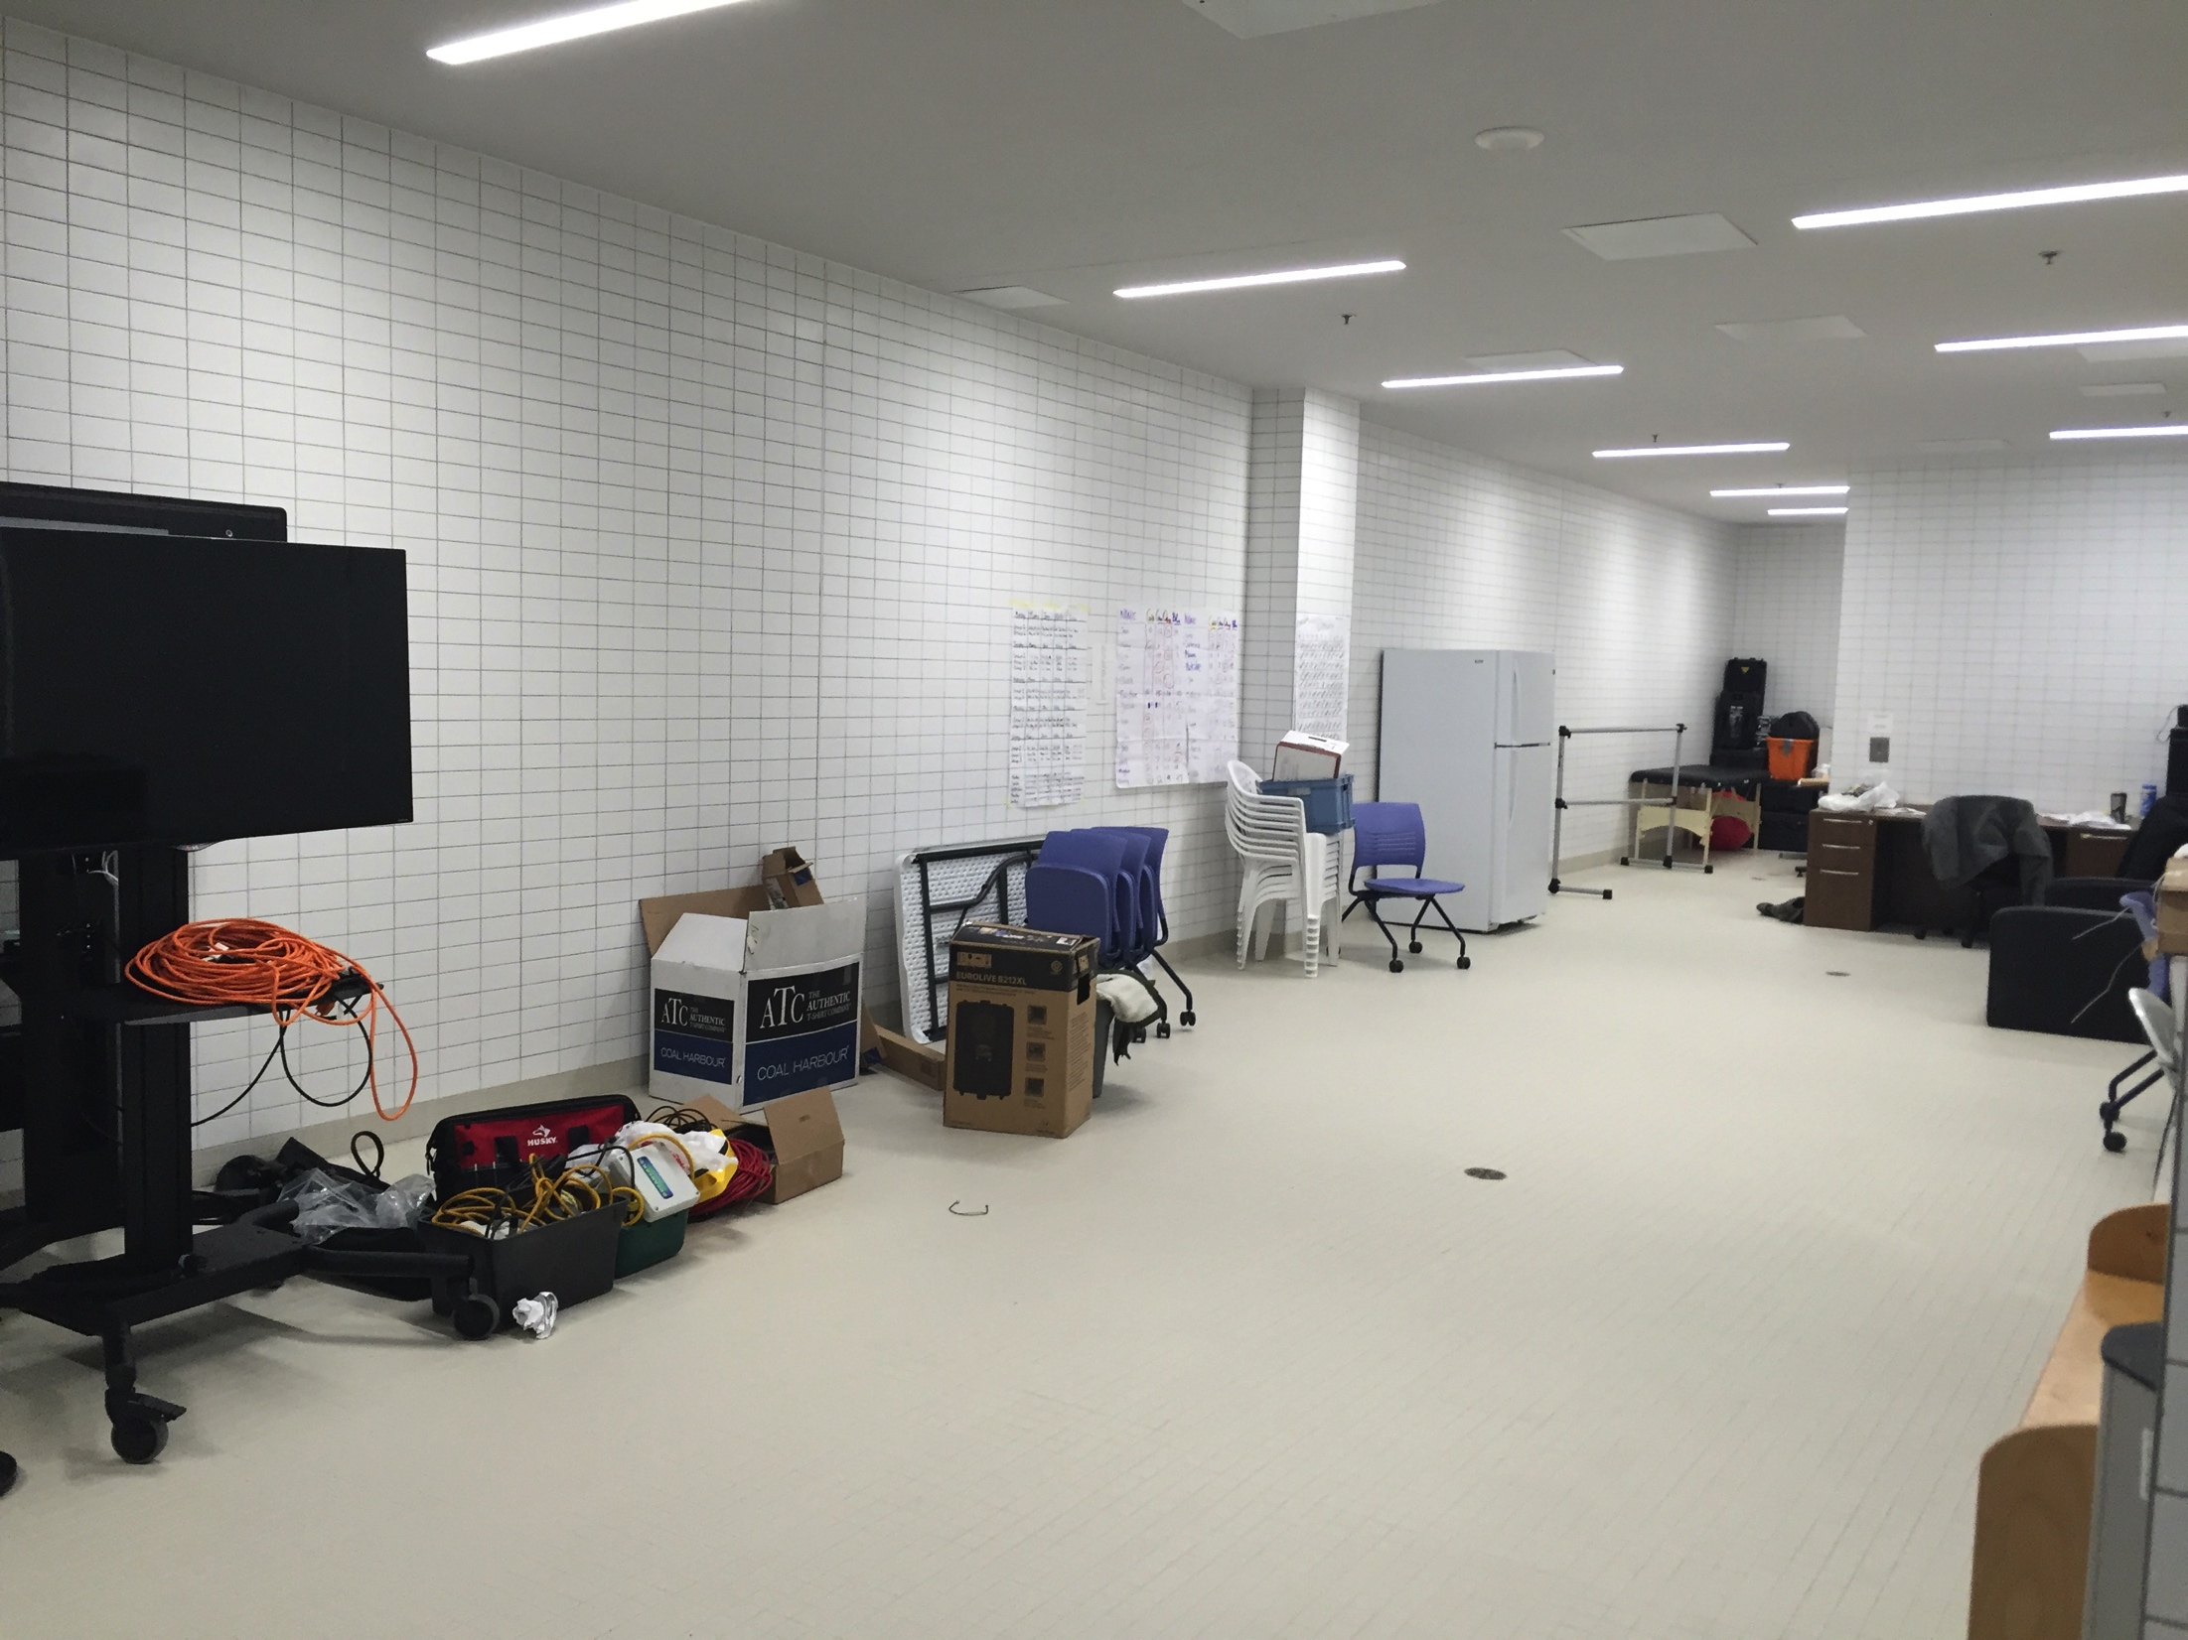
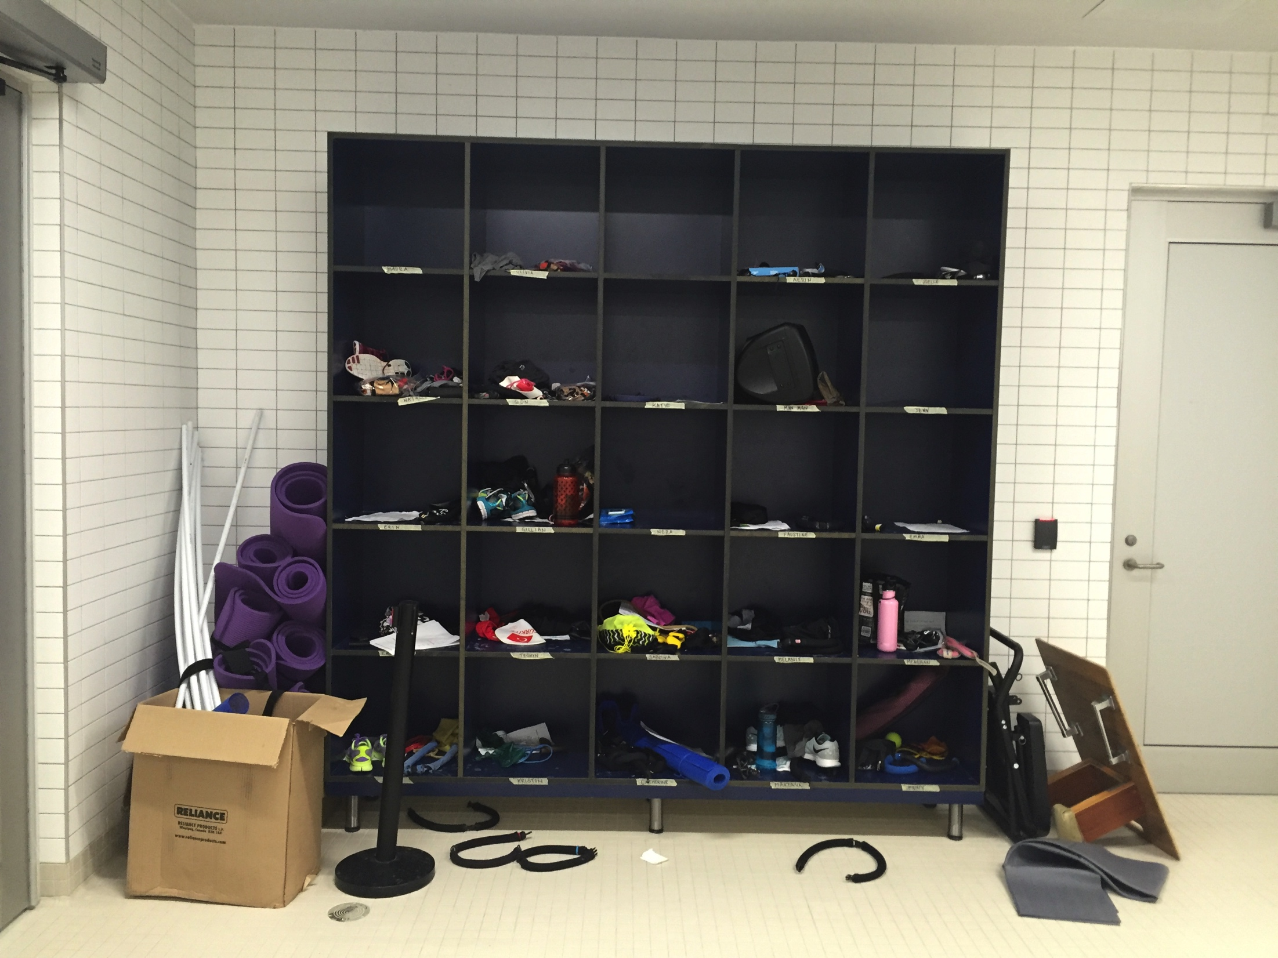
Synchro Canada/RTC Private Training Room

Slide 9
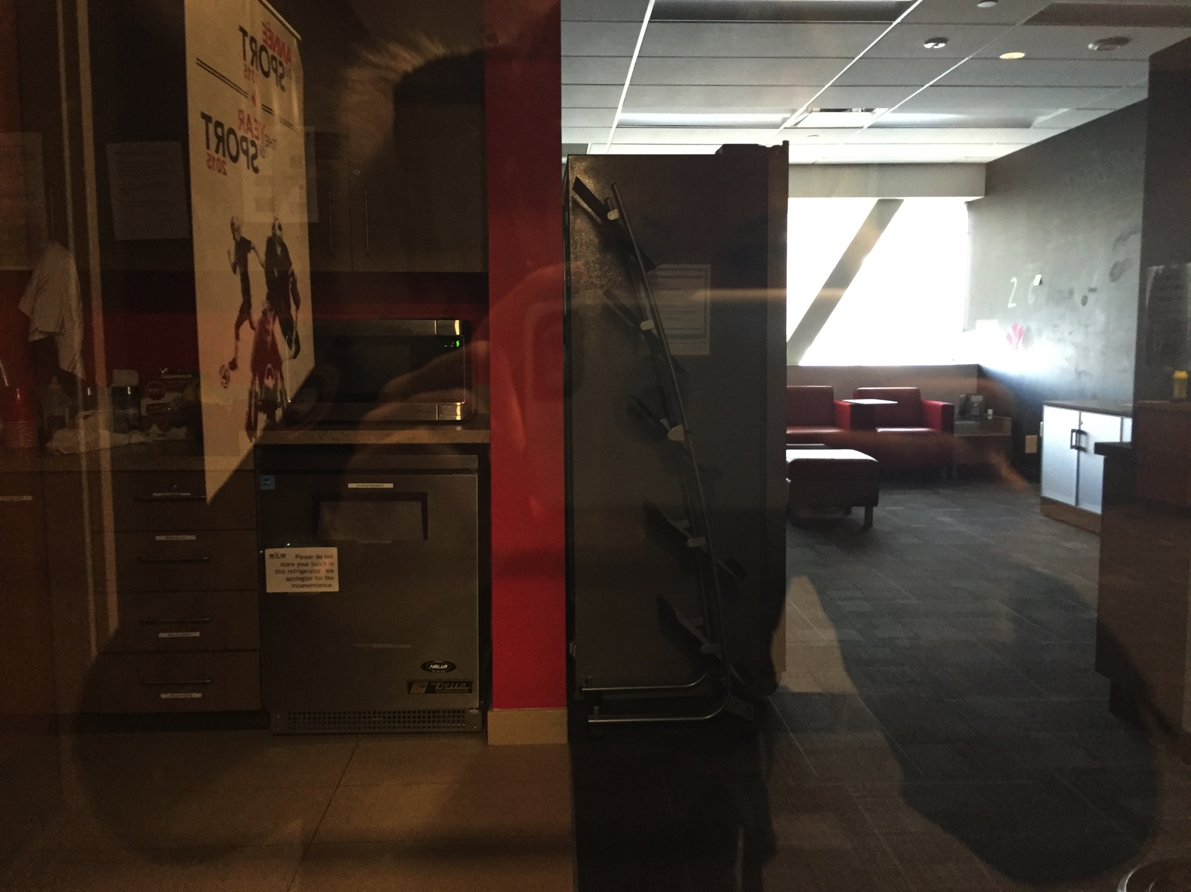
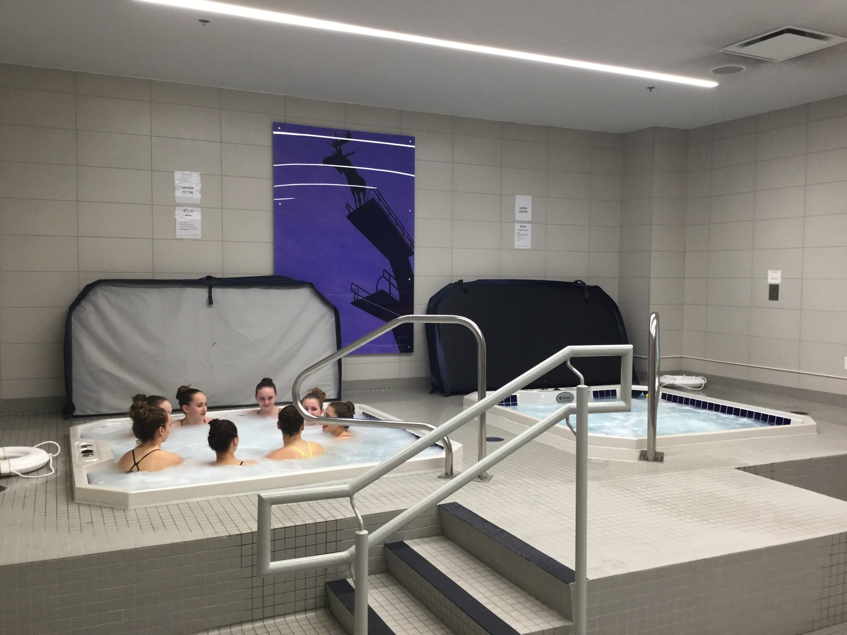
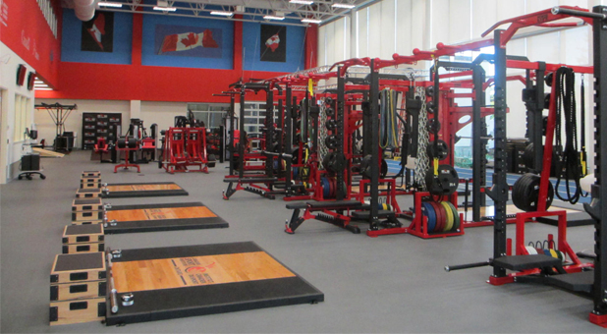
CSIO Training Area

Slide 10
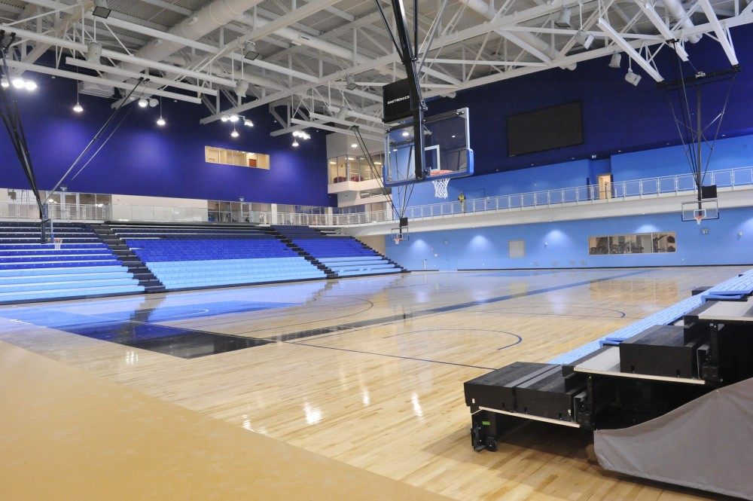
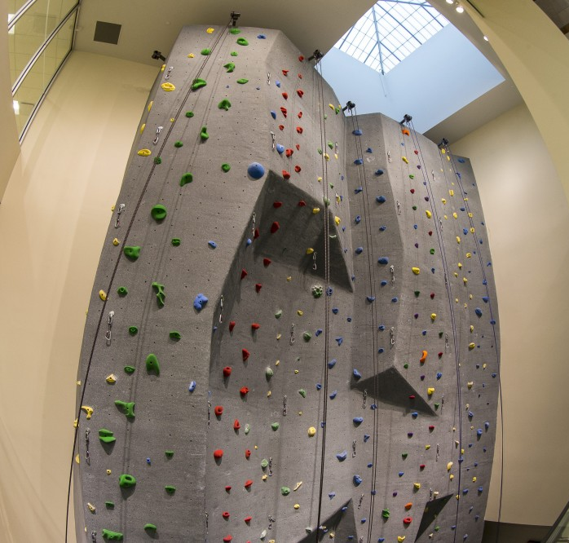
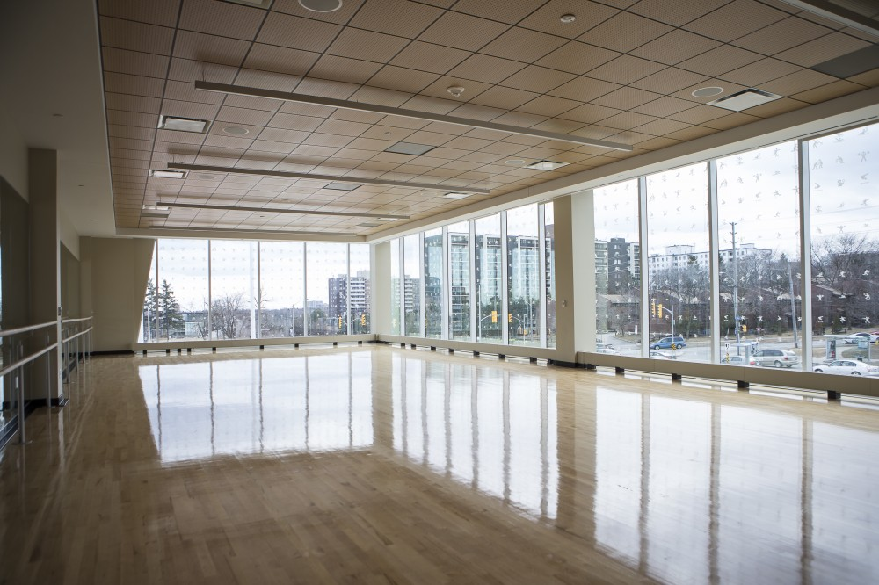
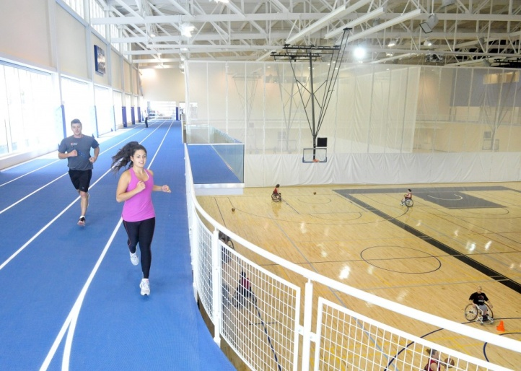
ACCESS TO TPASC FACILITIES
Leadership/Specialized Training & Team Work Areas Boardrooms Dance Studios Fieldhouse Rock Climbing Wall Food Court/Swim Apparel Store on-site

Slide 11
A typical day at the RTC
Video

Slide 12
ELIGIBILITY
The RTC is a Junior Training Environment
Athletes born in 2001 and earlier are eligible for entry into the RTC for the 2016-17 season
Athletes born after 2001 will only be considered if they are deemed to have exceptional abilities.

Slide 13
Selection process
Important Dates
Sunday May 15th – RTC Online Application Due
Selection Process: Must CHOOSE ONE of the two available sessions
Tuesday May 17th – evening
Tuesday May 24 – evening (After Age Groups)
Tuesday June 7th – Conditional Acceptance (after Espoir)
***Conditional upon review by CSIO Doctor and Physiotherapist
Tuesday June 14th – Acceptance and Deposit Due
Late June/Early July – Athlete Wellness Check Up
Early August – Official Acceptance/RTC 2016-2017 Roster Announcement

Slide 14
Skill assessment
Section 1:
Analysis of Competition Results (30% of Overall Score)
Section 2:
Athlete Application/Coach Endorsement (10% of Overall Score)
Section 3:
Athlete Physical (10% of Overall Score)
Section 4:
Synchro Skill Testing (20% of Overall Score)
Section 5:
Figure Skills (10% of Overall Score)
Section 6:
Routine Skills (10% of Overall Score)
Section 7:
Selection Committee Overall Impression (10% of Overall Score)

Slide 15
RTC PRIORITIES
1
In order for Canada to achieve the podium for both Duets and Teams at the Junior World Championships in 2018 and Olympic Games in 2020 and 2024, the Selection Advisory Committee reserves the right to make recommendations on athletes with specific abilities that will contribute to the Olympic Events as a first priority.
In order to have Canada be a leader in Highlights and Acrobatics, the Selection Advisory Committee reserves the right to recommend athletes with specific abilities in lifts and acrobatics as a subsequent priority in the ranking.
It is understood that athletes selected to the Athlete Pool are committed to high performance and are seeking to represent Canada in future International and Olympic competitions. As a point of reference for RTC applicants, Synchro Canada encourages athletes who qualify for the National Team to consider targeting two Olympic cycles of participation.
2
3

Slide 16
Next steps
What do you need to do to prepare for your RTC Tryout?
Work hard and continue to improve for the remainder of the season and use the Selection Criteria as your guide to training and working on personal gaps
Utilize the LTAD Monitoring Document and include these measurements in your Daily Training at the club as well as do a monthly measurement to track your progress
Complete the RTC Athlete Application for the RTC – due Sunday May 15th, 2016
Attend one of the two try-out dates
Utilize the LTAD Monitoring Document and include these measurements in your Daily Training at the club as well as do a monthly measurement to track your progress.
Train the Compulsory Junior Figures (Porpoise Twist Spin 720 and Barracuda Airborne Split) within your Daily Training
Speak with your Parent(s) and Coach(es) to discuss personals goals and if applying to the RTC is appropriate for you

Slide 17
contact
Jadine Cleary– Synchro Canada Domestic Technical Director
jadine@synchro.ca
Sheilagh Croxon– Synchro Swim Ontario Technical & High Performance Lead
scroxon@synchroontario.com

