Slide 1
New OAS Wellness Program: Fostering Healthy & Safe Sport
Laura Steacy, PhD
OAS Technical Director
Owner, Mind 2 Body Performance Consulting

Slide 2
Overview
What is Wellness and why is it important?
Findings from ISP Program Evaluation
Athlete and Coach Wellness Program info
Questions

Slide 3
Wellness: What is it?
Health
Physical
Psychological
Social
Total or sum of domains of health
Interplay between these different domains

Slide 5
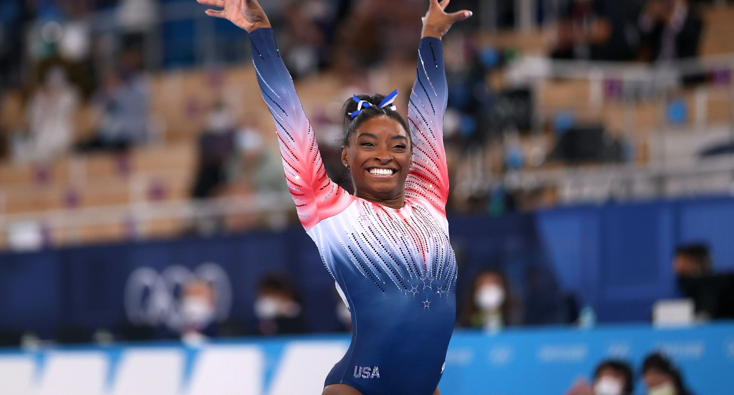
Wellness: Why is it important?
Photo source: nhl.com
Photo credit: Lindsay Wasson

Slide 6
Wellness: Why is it important?
LTD and developing “complete” athletes
Performance outcomes
Safe Sport

Slide 7
Wellness and Athlete Development
LTD holistic focus
Physical literacy components
Psychological components
CAS Gold Medal Profile
Intangibles

Slide 8
Wellness and Performance
Positive sport experience will encourage athletes to remain in sport
Depth of the talent pool
Driving performance through increased competition
Negative consequences of poor health/wellness are not compatible with peak performance
Physical injury
Depression, anxiety, eating disorders

Slide 9
Wellness and Safe Sport
2020 CAC Safe Sport training
Collective responsibility to promote physical, psychological and social health
2021 SIRCUIT Blog post Dr. Gretchen Kerr
Evolution of Safe Sport
Beyond harm prevention to optimization of the sport experience

Slide 10
Wellness & Coaching
Important for the same reasons!
Role models for our athletes
Important for coaches to feel respected and valued

Slide 11
OAS Injury Surveillance
Initial focus on concussions
Expanded to monitor all types of injuries
Summer 2020: ISP Program Evaluation
Surveyed athletes and coaches
Main objectives:
User feedback on the ISP process and tools
Gain understanding of athlete experience

Slide 12
Findings: Injury Tracker
More answer options
More clarity
Web-based follow-up form
More information/awareness around the process and the role of the coach

Slide 13
Findings: Athlete Experience
Over 75% of athletes reported sustaining an injury during artistic swimming training
Over 50% reported hiding training injuries from their coach in the past
Barriers:
Didn’t think it was bad enough/I could push through
Didn’t want to miss any training

Slide 14
Findings: Athlete Experience
Perceptions of experience with injury:
Common perception that most injuries occur in dryland and flexibility training
NOT supported by data
Feel supported by coaches during injury recovery, but not always from others (team mates, parents)
Mental health conditions not taken as seriously/not receiving as much support

Slide 15
Evaluation Take-Aways
ISP needed to be re-vamped
More support and education for coaches in how to use the tools and follow the process
More resources for athletes to educate and empower them about their own health
More resources directly relating to mental health support

Slide 16
OAS Wellness Programs
Athlete Wellness Program
New and updated policies and guidelines
Updated Injury Tracking program
Online Health Hub
Wellness Webinars
Coach Wellness Program
Health Hub
Wellness Webinars
Working on more!

Slide 17
Athlete Wellness Program
New and updated Policies/Guidelines:
Updated OAS Concussion Policy
Aligned with CAS policy and compliant with Rowan’s Law
Updated OAS Concussion Guidelines and Return to Pool Protocol
Para-athletes

Slide 18
Athlete Wellness Program
OAS Health & Wellness Policy—NEW
Return to Pool Guidelines—NEW
RTP after Mental Health challenges by Greer Kelly
Updated Injury Tracking Program
Updates to Injury Report form
Web form based Concussion Follow-Up
Updated instructions in different media

Slide 19
New Health & Wellness Policy
Provides a framework for guiding decision-making when an athlete suffers from an injury or illness
Outlines everyone’s role in fostering athlete health and wellness
Guiding principles:
Safety
Support
Health promotion
Inclusion

Slide 20
New Return to Pool Mental Health Guidelines
Huge thank you to Greer Kelly for her work
Two main components:
Graduated return
Team Meetings
Graduated Return: stages of increasing participation
Team Meetings: athlete meets with members of their support team with defined objectives

Slide 21
New Health Hubs
Online portals with resources supporting the multiple facets of health & wellness
Separate portals for athletes and coaches
Specific to the needs of each group

Slide 22
New Wellness Webinars
Content focused to each specific audience
Topics related to different facets of health
We want to hear from you!

Slide 23
Implementing the Wellness Program
Use the program! ☺
Encourage your athletes to use the program
Promotion tool-kit
Send your feedback, we want to hear from you!

Slide 24
Thank you!
Questions?

